Slide 1


NAME: PRIYANSH SANDIPKUMAR BHAVSAR
ENROLL NO: 22002171220002
BRANCH: CSE
ROLL NO: 385

Slide 2

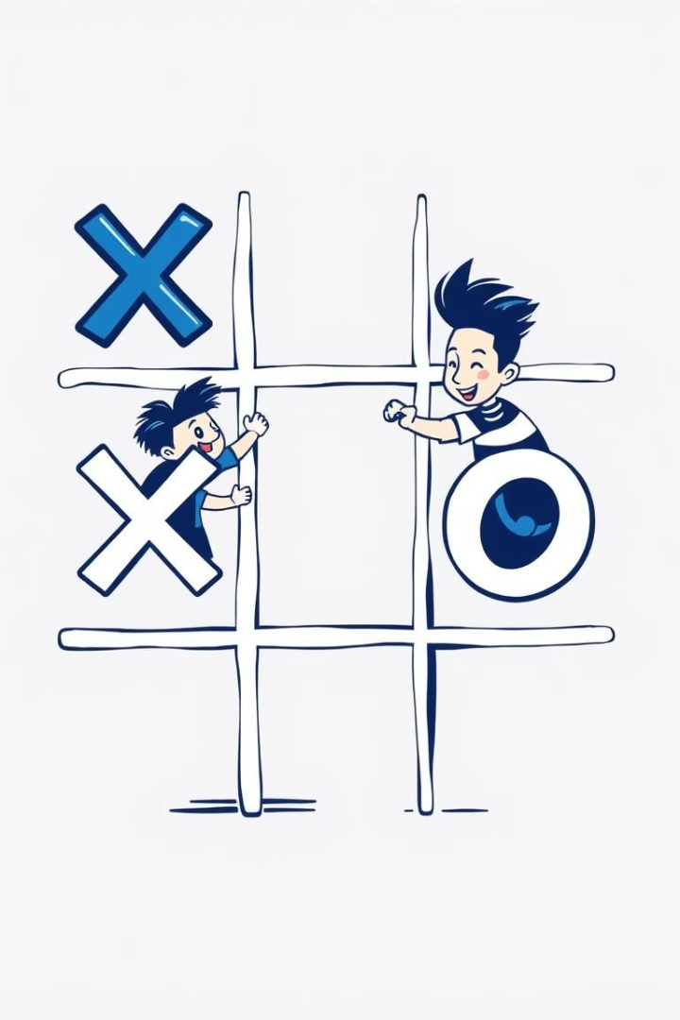
Introduction to Tic-Tac-Toe
Simple Rules
Classic Gameplay
Tic-Tac-Toe is a two-player game played on a 3x3 grid, where players take turns placing their marks (X or O) to achieve a winning three-in-a-row.
It's a game of strategy and anticipation, where players must carefully consider their moves to outmaneuver their opponent and secure victory.

Slide 3
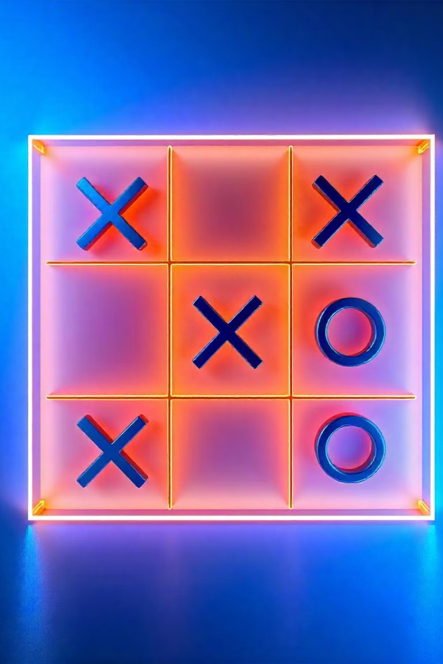
Rules of the Game
The game is played on a 3x3 grid.
Players take turns placing their mark (X or O).
The first player to get three of their marks in a row, column, or diagonal wins.
If all squares are filled and no player has three in a row, the game ends in a draw.

Slide 4
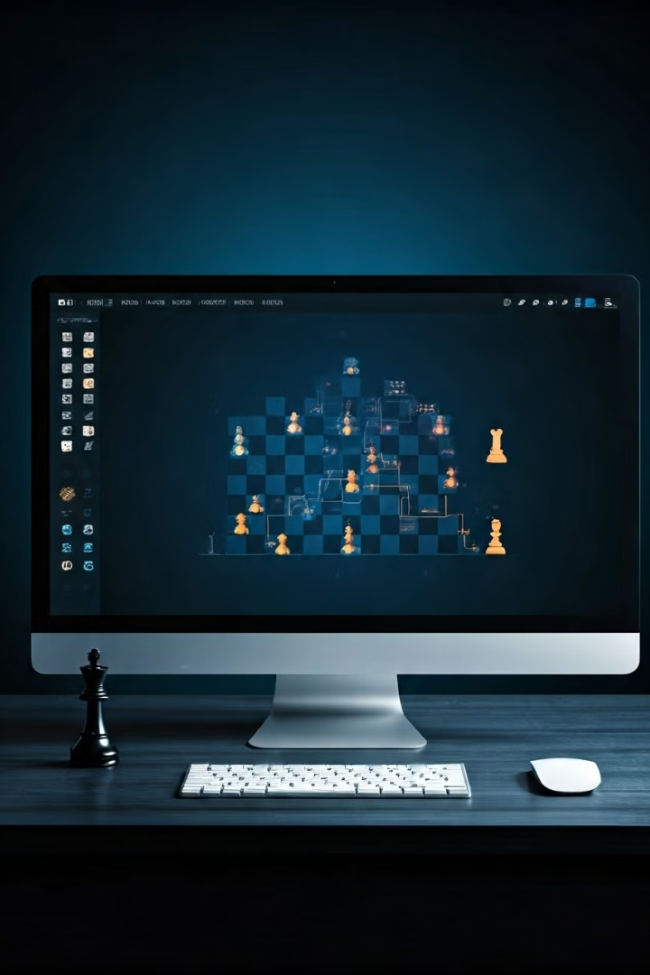
The Minimax Algorithm in AI Decision-Making
The minimax algorithm is a powerful tool used in artificial intelligence (AI) to make optimal decisions in games and other strategic situations. By simulating future game states and evaluating potential outcomes, it enables AI to select the move that maximizes its chances of winning while minimizing the opponent's chances.

Slide 5
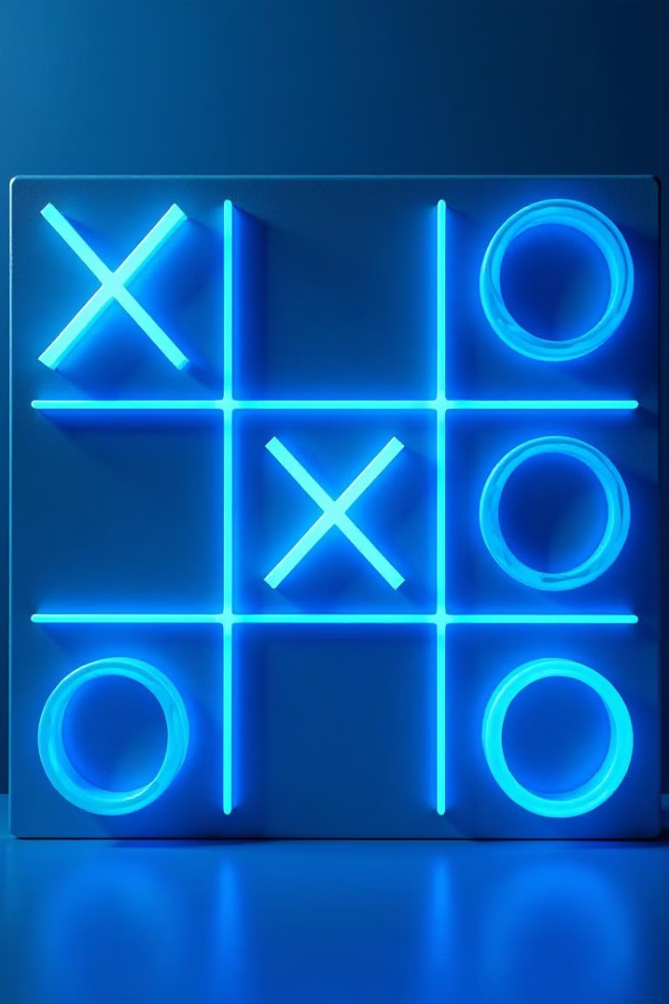
Understanding the Game Flow
1
Player 1's Move
Player 1 places their mark (X) on an empty square on the grid.
2
Player 2's Move
Player 2 places their mark (O) on an another empty square.
3
Winning Condition
The game continues until one player achieves three in a row or all squares are filled.

Slide 6

The AI's Strategic Approach
1
Predicting Moves
2
Optimal Choices
The AI analyzes all possible moves, considering their potential outcomes and consequences.
It selects the move that maximizes its chances of winning or minimizes its chances of losing.

Slide 7
Exploring the Minimax Algorithm
Recursive Approach
Maximizing & Minimizing
The algorithm explores all possible moves to a certain depth, evaluating the potential outcome of each move.
It uses a recursive function to evaluate moves, maximizing the AI's chances of winning and minimizing the opponent's chances of winning.

Slide 8
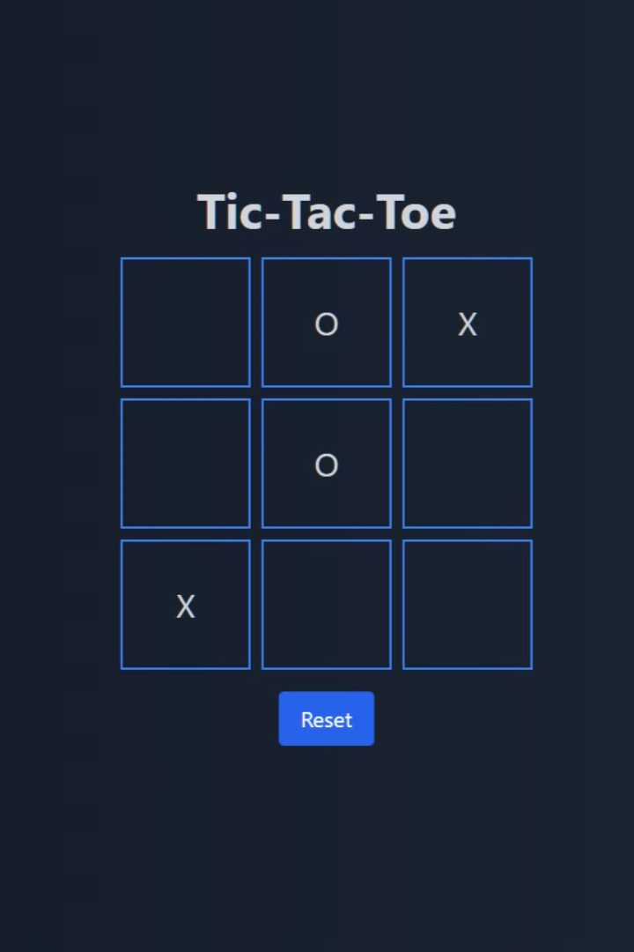
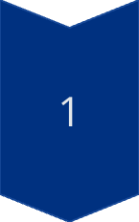
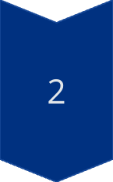
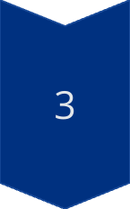
Visualizing the Minimax in Action
Move Evaluation
The AI evaluates each possible move, considering the potential outcomes for both players.
Optimal Choice
The algorithm selects the move that maximizes the AI's chances of winning or minimizes its chances of losing.
Game State Update
The selected move is made, updating the game state and prompting the opponent's next turn.

Slide 9
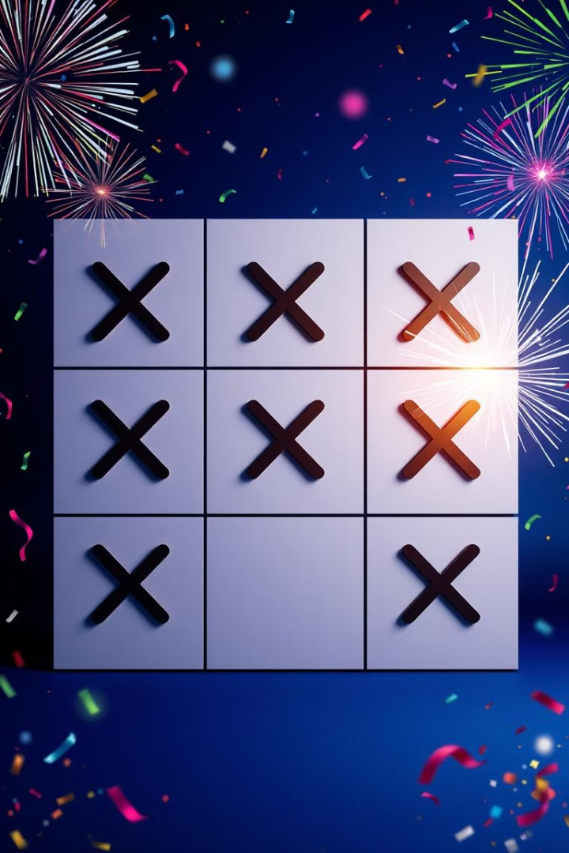
Conclusion and Key Takeaways
Strategic Thinking
Game Mastery
The minimax algorithm demonstrates the power of AI in strategizing and making optimal moves.
By predicting outcomes, the AI can play a near-perfect game, showcasing its ability to outmaneuver opponents.

Slide 10
THANK YOU

